Slide 1


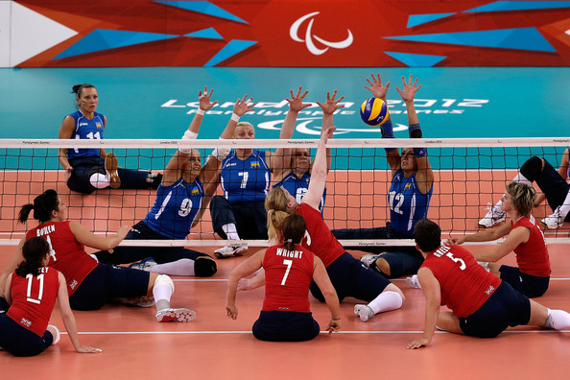
SITTING VOLLEYBALL
Come and try this exciting variation of the game
Open to everyone able bodied and disabled
All Saints SC, Norfolk Park Road, Sheffield
Thursday 7.00pm – 8.00pm
Cost £2 per session
Email info@sheffieldvc.org.uk for more details
www.sheffieldvc.org.uk

