Slide 1
Co-production Workshop
14th June 2017
DRAFT Version 1

Slide 2

Overview
What is Co-production?
Reflecting on our own experience
Getting to know the Common Approach through an Integrated Personal Commissioning lens
Answering questions and concerns
What next?
Notes:
10:35 – 10:40
Give the general over view of the day

Slide 3

Working together comfortably
Mobile phones off or on silent
Responsibility for our own comfort
Allow everyone the chance to speak
Ask the questions that are in your head
We all have knowledge to share and we’re all learning
5 minute rule and “park the issue”

Slide 4
What is Co-production?
Co-production is where professionals and people with lived experience of long term health conditions work together to plan support, in partnership.
It was described by Think Local Act Personal, as
“a meeting of minds coming together to find shared solutions.”
It’s also about people working together so that we move away from ‘doing to’ people to an approach that is ‘doing with’.

Slide 5
Is Co-production the same as peer support?
When we talk about our approach to co-producing Integrated Personal Commissioning, we are talking about ‘strategic co-production’. Put simply, it’s about people with lived experience working alongside NHS England and local sites to help achieve the aims and objectives of the Integrated Personal Commissioning Programme. When we say ‘strategic’, we mean working ‘at a high level’.
Peer support is something very different
Peer support is about people with lived experience coming together on a 1:1 level, in a group or maybe online to provide practical and emotional support to each other so they can self-manage their health condition.

Slide 6
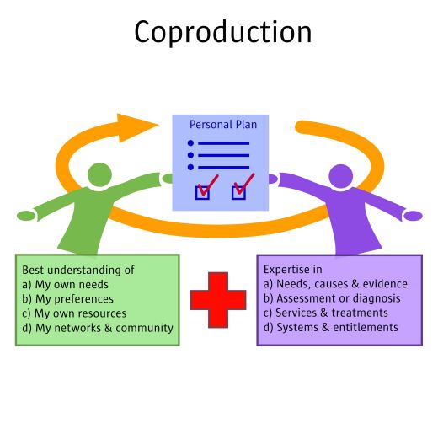
Hey! Hold on a minute…
Yes, you’re right ! The term co-production is used in various ways by different people. It’s also used when we talk about writing personalised care and support plans…
(Graphic by Simon Duffy, Centre for Welfare reform)
BUT…for the purposes of this workshop, we are talking about strategic co-production and the Integrated Personal Commissioning Programme.

Slide 7
So what is Integrated Personal Commissioning (IPC)?
Through IPC, people, carers and families with a range of long-term conditions and disabilities are supported to take a more active role in their health and well-being. This includes better information and access to support in their local community, and with greater choice and control over their care.
The purpose of IPC is:
Better outcomes and quality of life for people with complex needs
Prevention of crises that lead to unplanned hospital admissions
Better integration and quality of care, including better individual and family experience of care.

Slide 8
When we look at the aims of IPC and the aims of co-production we can see they are the same !
Here are a few of examples…….
IPC aims to empower people to play an active role in their own health and well-being
It involves a different and more proactive relationship between people with health and care needs and the NHS and Social Care
It aims to build people’s knowledge, skills and confidence
It takes an asset-based approach (in other words, it looks at what resources, skills and abilities people have rather than the things they can’t do!)
It’s about moving away from ‘doing to’ people to ‘doing with’ them.

Slide 9
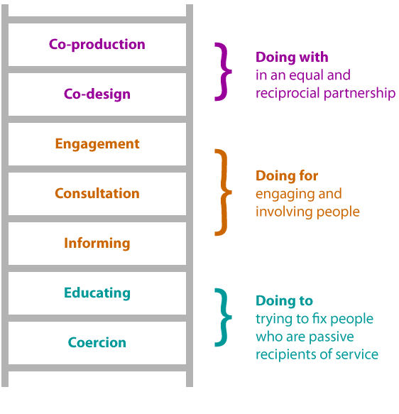
Co-production ladder

Slide 10
‘Doing with’: a change in relationship
The changed relationship is key to Integrated Personal commissioning. Both Integrated Personal Commissioning (IPC) and Co-production promote:
  A shift in power and decision making to enable people to take more control about decisions around their care
  A change in relationship between health practitioners and people who use health and social care services
  Addressing the power and information imbalance between people, families and statutory organisations.

Slide 11
So what does this look like in practice?
Strategic co-production enables people with lived experience and their carers to play an active role in:
Working with NHS England, IPC sites and other key stakeholders to co-design the IPC offer – it’s the best way to help ensure that IPC works well for people
Working with NHS England, IPC sites and other key stakeholders to ensure that what is being offered to people is clear, empowering, and outcome-focused – IPC has got to make sense to people so they feel confident to try it
Working with NHS England, IPC sites and other key stakeholders to influence at a high level and so we can realise the IPC vision together

Slide 12
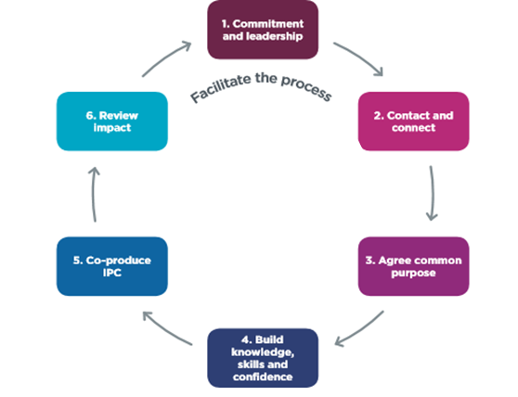
Strategic Co-production
One of the most effective ways of developing strategic co-production is through developing a Co-production peer network.

Slide 13
Thinking about our own experiences
What makes a group work well?
What makes a group go wrong?

Slide 14
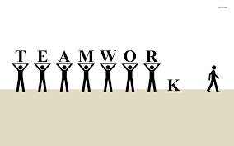

Thinking about our own experiences
What makes a group go wrong?
People having their own agenda

Slide 15
Thinking about our own experiences
What makes a group go wrong?
No purpose
Poor Environment

Slide 16
Thinking about our own experiences
What makes a group go wrong?
No purpose
Poor Environment
People having their own agenda

Slide 17
Thinking about our own experiences
What makes a group go wrong?
No purpose
Poor Environment
People having their own agenda

Slide 18


Thinking about our own experiences
What makes a group work well?

Slide 19
Thinking about our own experiences
What makes a group work well?
Good Facilitation

Slide 20
Thinking about our own experiences
What makes a group work well?
Good Facilitation
Respecting other opinions

Slide 21
Thinking about our own experiences
What makes a group work well?
Good Facilitation
Respecting other opinions
Having a shared vision/common purpose

Slide 22
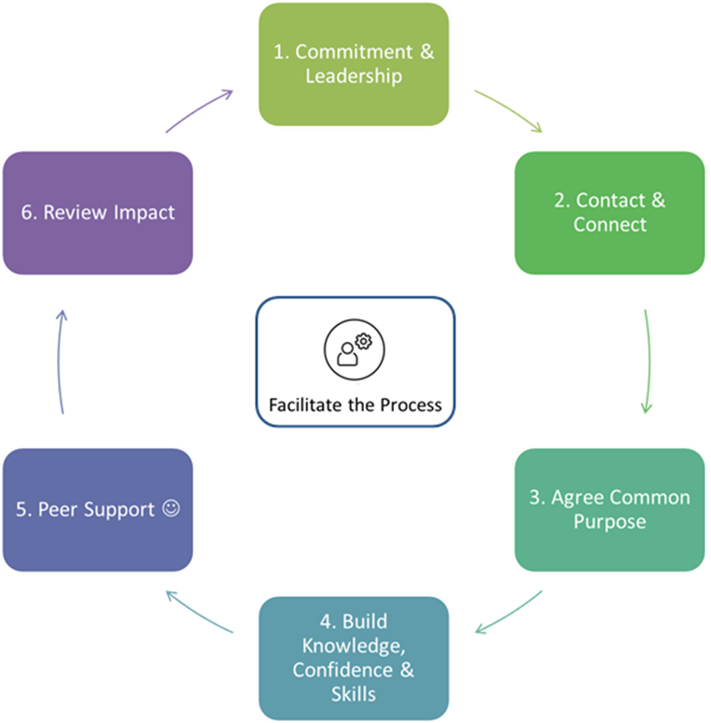
6 Phases of Co-production
5. Co-produce IPC

Slide 23
Commitment &
Leadership

Slide 24
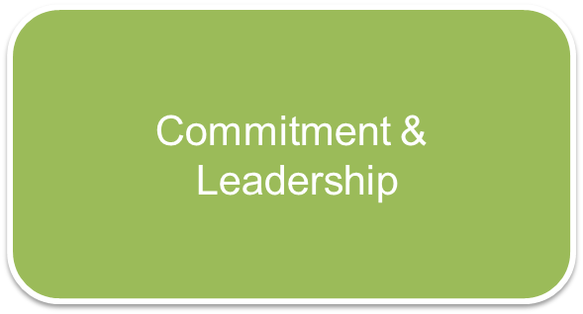
Phases of Co-production
Why?
So that it isn’t a side issue but is central to decision making within IPC
So that people feel valued and that their input is listened to
So that there is a shared understanding of what IPC is trying to achieve, both as organisations and as individuals

Slide 25
Phases of Co-production
How?
Developing a co-production strategy that demonstrates leadership, values and commitment in practice means:
There is adequate time and resources available.
An identified lead person within the IPC work-stream
A skilled facilitator to develop a co-production peer network.

Slide 26
Contact &
Connect

Slide 27
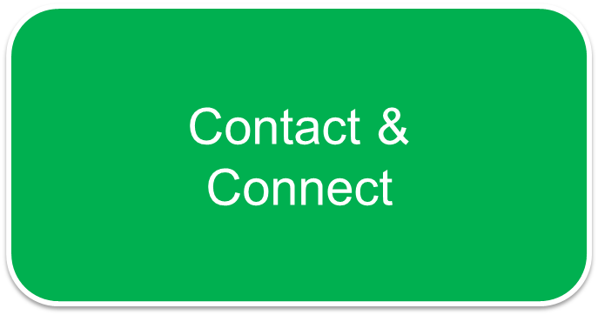
Phases of Co-production
Why?
To reach local people with direct experience
To ensure that the people who are doing co-production have the most relevant experience for IPC
To grow an effective group of people

Slide 28
Phases of Co-production
How?
Make any invitation short and friendly. Be clear about what is being offered to people.
Have meetings in an informal, accessible community setting not an office.
Let people know if their travel expenses may be reimbursed and that there will be some refreshments.
Be clear with everyone that the contacting and connecting is to people with lived experience, and why.

Slide 29
Agree a Common Purpose

Slide 30
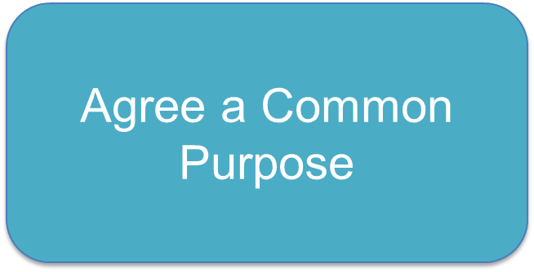
Phases of Co-production
Why?
It’s important to be clear about what the group are trying to achieve and how that will happen
To be clear about the scope of everyone’s commitment.
To co-create a vision for IPC on how we will work together

Slide 31
Phases of Co-production
How?
Take time and work through stages of group development
Group gain an understanding of IPC and local context
Explore and agree group and individual priorities and create statement of purpose
Invite senior decision maker in to negotiate and agree priority areas of work

Slide 32


Slide 33
Phases of Co-production
Why?
So that people feel confident and competent to contribute on a level-playing field.
So people understand what is open to change and what is not, so that they can offer realistic and informed input
So that people have the necessary knowledge to understand their own lived experience in the context of the bigger picture
To encourage people to share their own personal experiences and champion IPC

Slide 34
Phases of Co-production
How?
Bring someone into the group who has had a good experience of co-production and can describe their own journey as someone with lived experience.
Talk to the group in ordinary language about Integrated Personal Commissioning.
Have input from various leads within the IPC programme, so that people have a solid understanding of the aims of IPC
Give people time and a safe space to ask questions and test thinking

Slide 35
Co-produce IPC

Slide 36
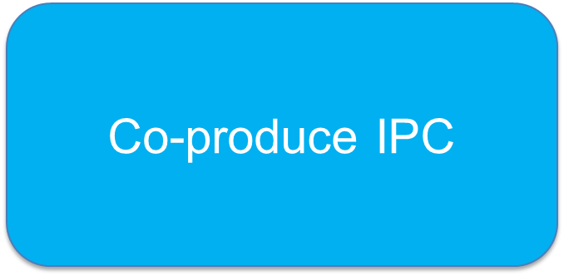
Phases of Co-production
Why?
To make sure that IPC genuinely works for people
To create a feedback loop so that decision makers hear what is working and not working
To establish a change in relationship between decision makers and people with lived experience
To further the development of IPC

Slide 37
Phases of Co-production
How?
Decision makers to bring real work into the group around development of IPC
Group to have a range of opportunities to contribute and influence
Develop reciprocal relationships between decision makers and people with lived experience
Have positive expectations about what can be achieved

Slide 38
Review Impact

Slide 39

Phases of Co-production
Why?
To keep people engaged and committed to the group
To ensure there are tangible outputs and meaning to the work
To ensure that IPC is transparent and that people feel empowered
To help drive demand for personal health budgets and IPC

Slide 40
Phases of Co-production
How?
People to hear directly from decision makers about what has happened on the issues they have contributed to
Celebrate success and progress with everyone involved
To regularly reflect on the impact that the group have had on IPC and the value they are adding to the decision making process

Slide 41

Reflections?
What has most struck you about what you’ve heard?
What would you like to ask more about? Questions? Concerns?
Notes:
12:12 – 12:17
5 minutes for reflections on tables of what you have heard today and gather together any questions you may have and look back at the hopes you put on the board to see if we have managed to achieve them.

Slide 42

Our ‘Approach to Strategic Co-production’
ON YOUR TABLE YOU WILL FIND A SET OF STATEMENTS,
DIVIDE THEM INTO ‘WHAT IS’ & ‘WHAT ISN’T’ CO-PRODUCTION.
Notes:
11:17 – 11:18
Introduce the activity on the tables there is 15 minutes for them to give it a try
11:33 – 11:34
Gather them back up and finish off

Slide 43
Our ‘Approach to Strategic Co-production’
What it is | What it isn’t
A chance to work alongside decision makers and influence IPC A facilitated process that develops people’s knowledge, skills and confidence An opportunity to build relationships, both with each other and practitioners A chance to do focussed pieces of work and make a difference | A chance to campaign about what is going wrong in health and social care! Putting the voice of people ahead of practitioners Formal meetings that are chaired A group that focuses on listening to each others problems A chance to change the whole system for the better
Notes:
Next 3 slides 11:34 – 11:39
This slide Approx. 1 mins

Slide 44
Achievements – Co-producing the programme nationally
Interviewing sites to become part of the IPC programme
Creating key features of a personal health budgets and IPC
Presenting at national events including Voluntary Sector events and Rolling out Personal Health Budgets
Contributing to the national Direct Payments Guideline for personal health budgets

Slide 45



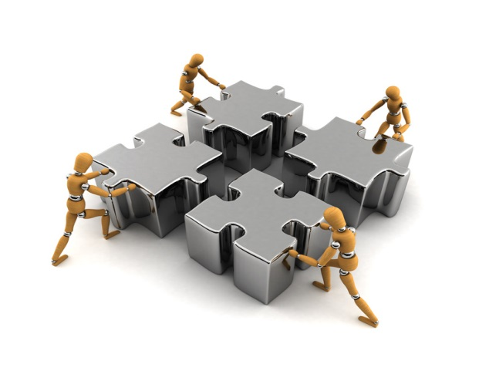
Next steps

Slide 46
Thank you!
Safe journey home

